Slide 1
Data Science
Joshua Richardson

Slide 2
Background and Purpose
The problem is that community-based medicine doesn’t always provide evidence-based care. This project intends to improve community-based care through practice transformation and IT.
Few data (at a system level) exist to explain or solve this problem. These unique data represent system-wide clinics that were randomized to receive practice transformation with IT against clinics that received practice transformation only.
The hypothesis is that clinics that receive practice transformation with IT perform better than clinics that receive practice transformation only, over time.

Slide 3
Project Design Writeup
Hypothesis is, clinics that receive practice transformation with IT perform better than those that receive transformation only, over time.
Describe if results differ by patient condition (n=4).
Specific features include that there are different measures for across conditions (n=6).
Goals and criteria are to authoritatively report that any differences (or not) are associated with the intervention.

Slide 4
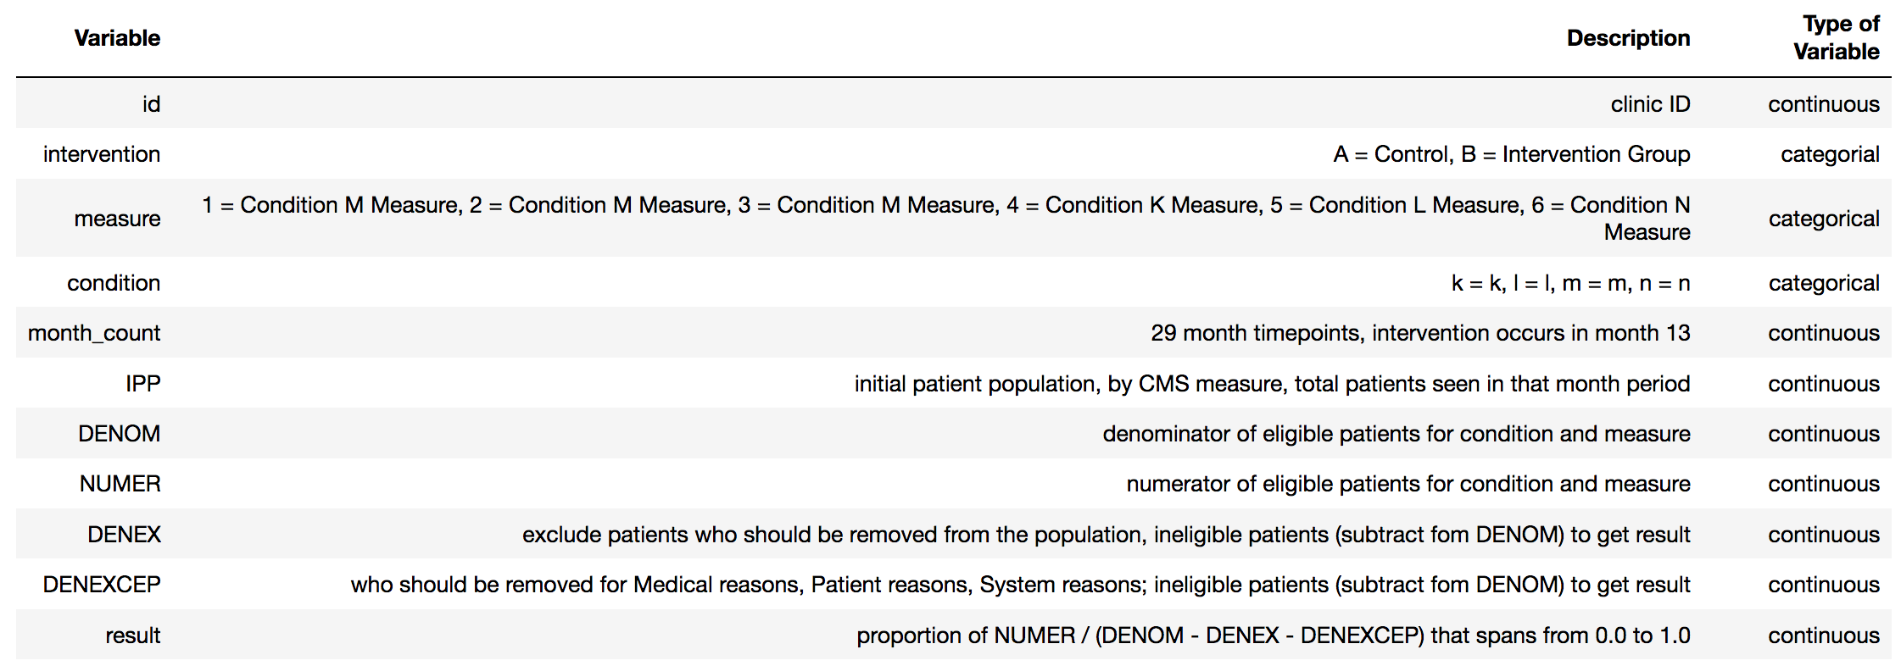
Data Dictionary

Slide 5
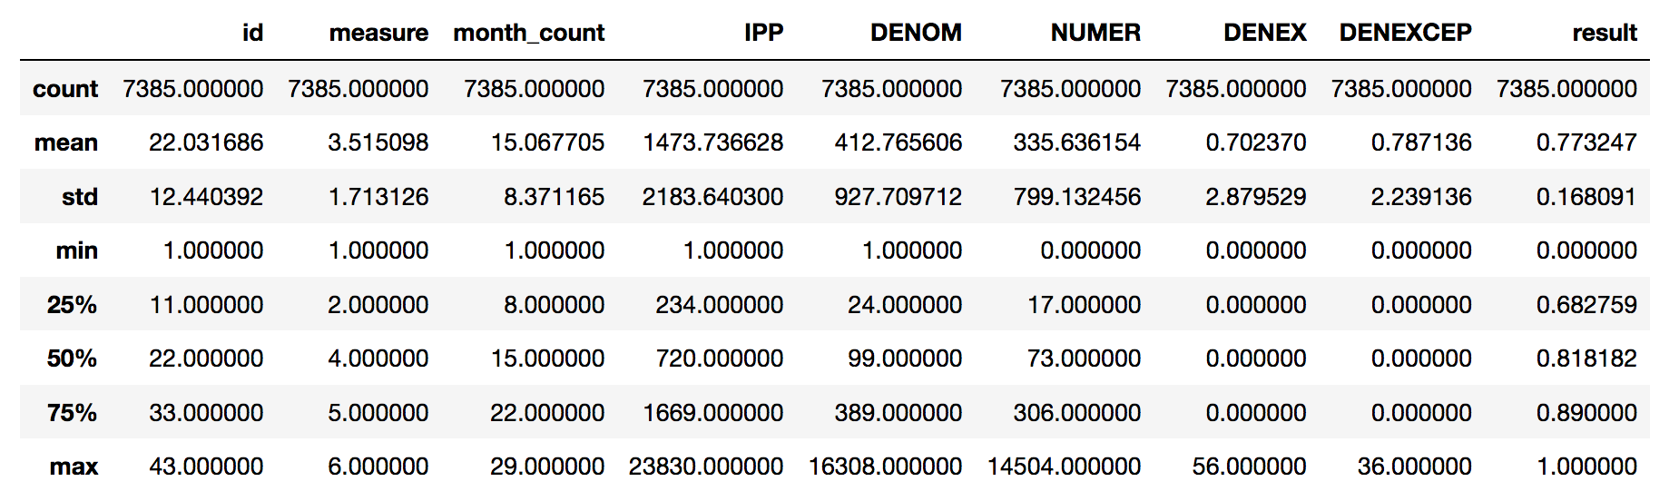
Overall Data

Slide 6

Comparison Group N

Slide 7
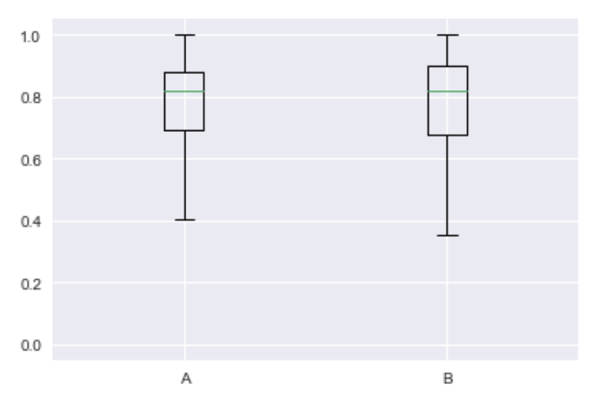
Intervention had higher spread

Slide 8
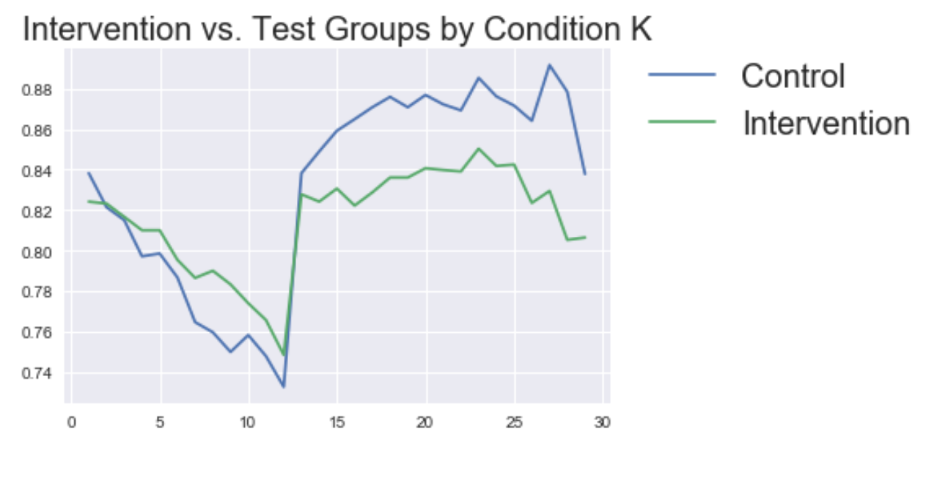
Goal: Compare Result (performance) over time

Slide 9
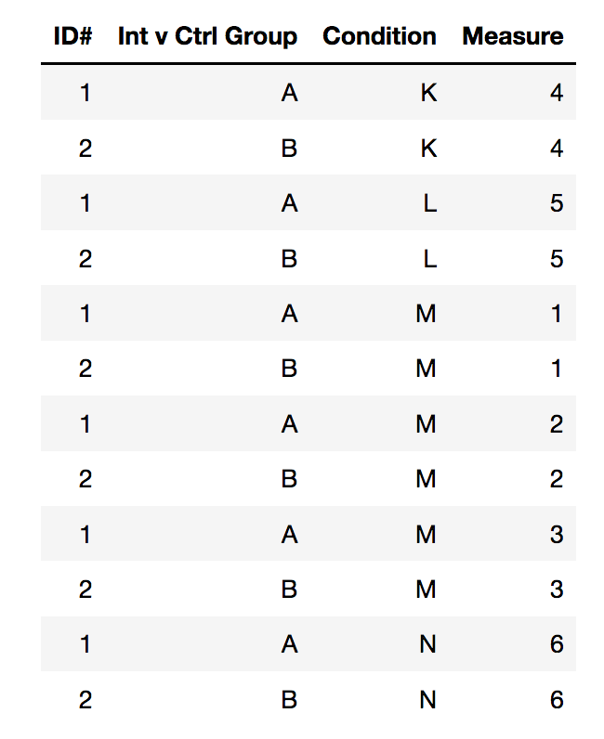

Slide 10
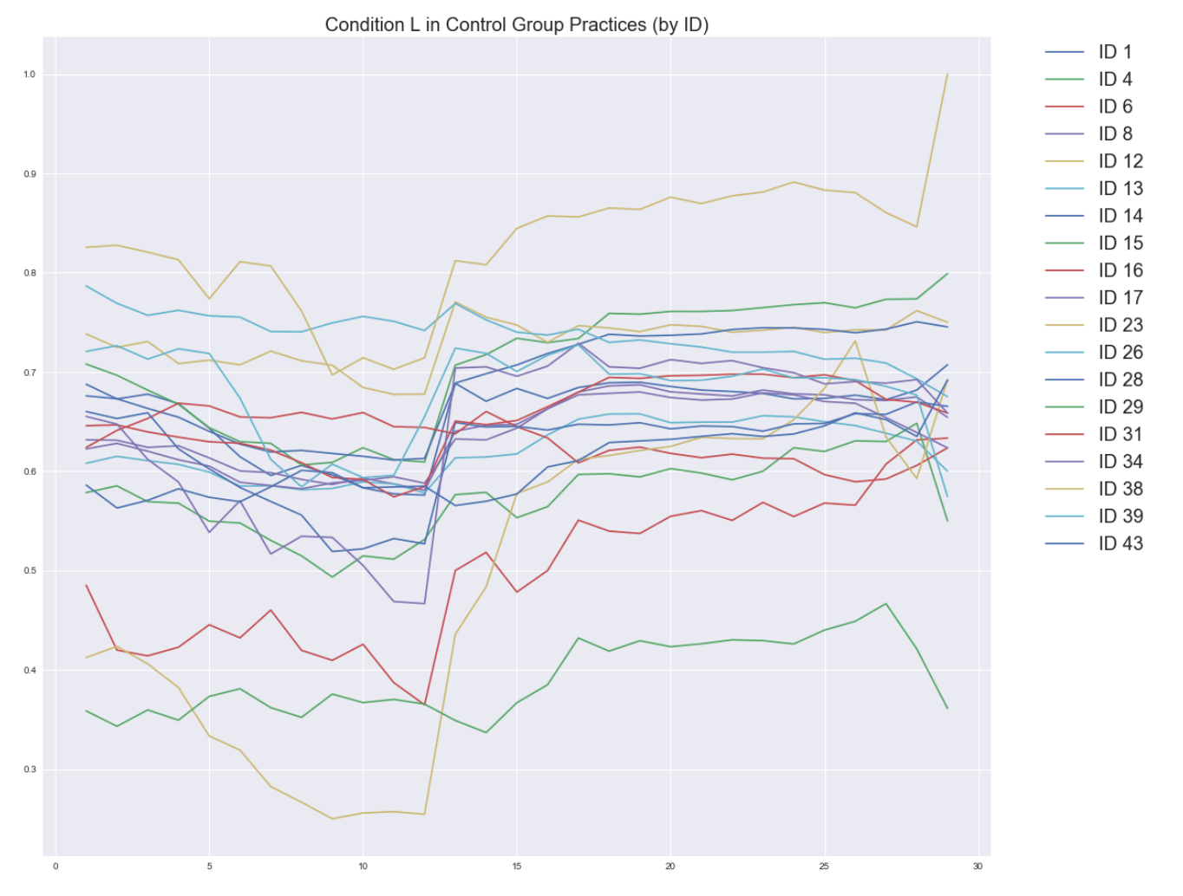
Compare all control (A) practices against themselves

Slide 11
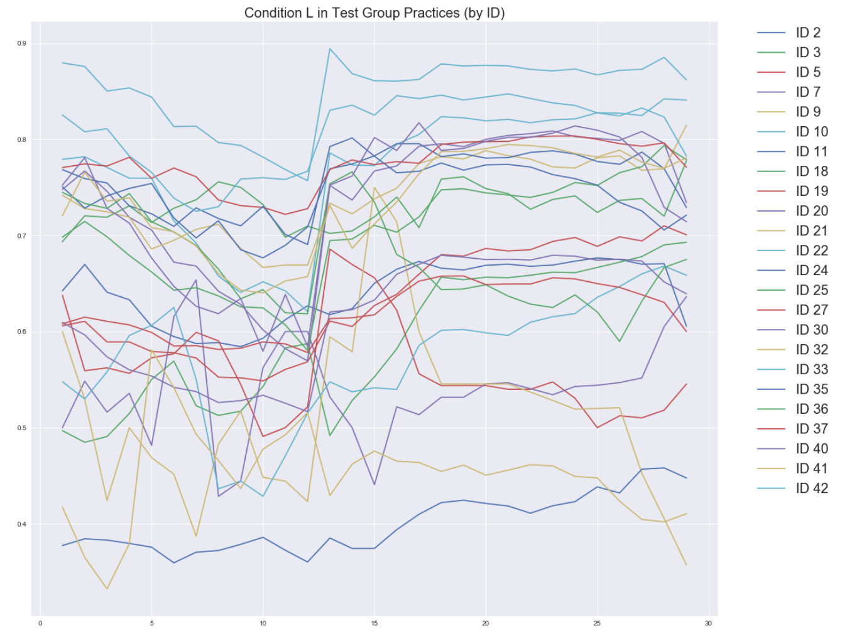
Compare all intervention (B) practices against themselves

Slide 12
Comparing paired t-tests across 3 conditions
Condition | Control (A) | Intervention (B) | <.01
K | 0.005 | 1.143E-11 | Y
L | 1.68E-35 | 1.391E-47 | Y
N | 9.8579E-24 | 2.16E-10 | Y

Slide 13
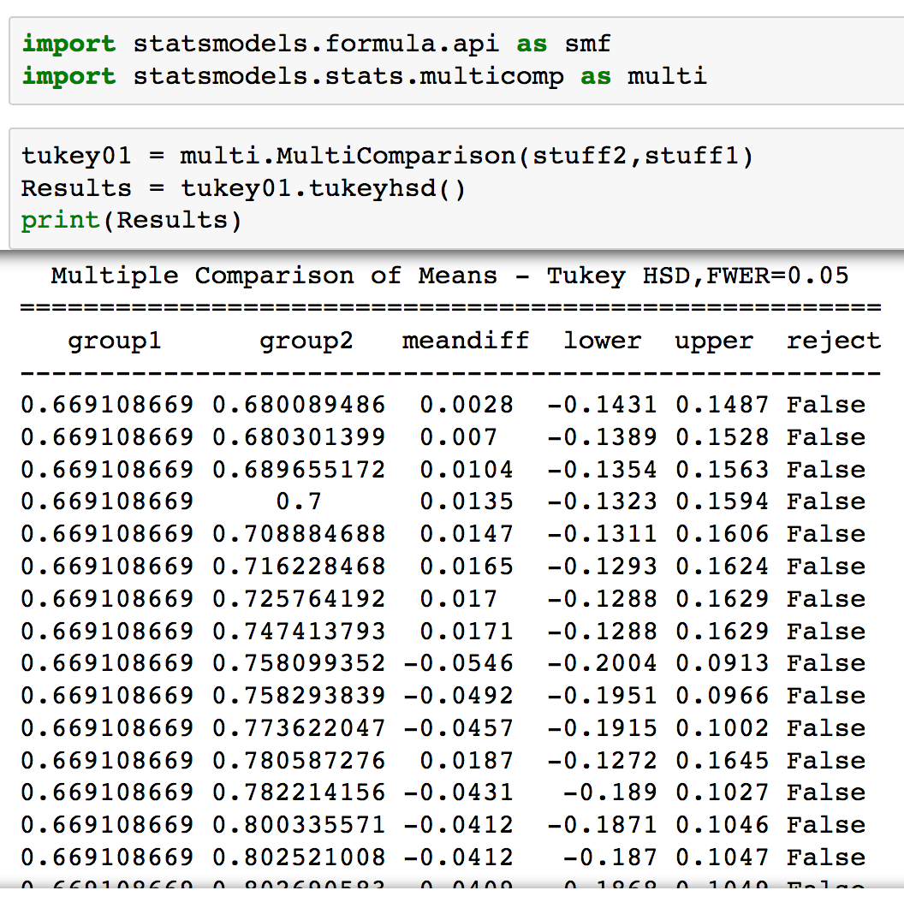
Tukey’s HSD Test
No significant difference in means across practices and conditions between groups (???)

Slide 14
Conclusion
There are statiscally significant differences (p-value < .001) for 3 conditions (K, L, N), and therefore I reject the null hypothesis and accept the alternative for both Control and Internvetion groups.
However the Intervention group p-value was further away from .001 than the Control group.

